Slide 1
Using Venn Diagrams to Compare and Contrast

Slide 3

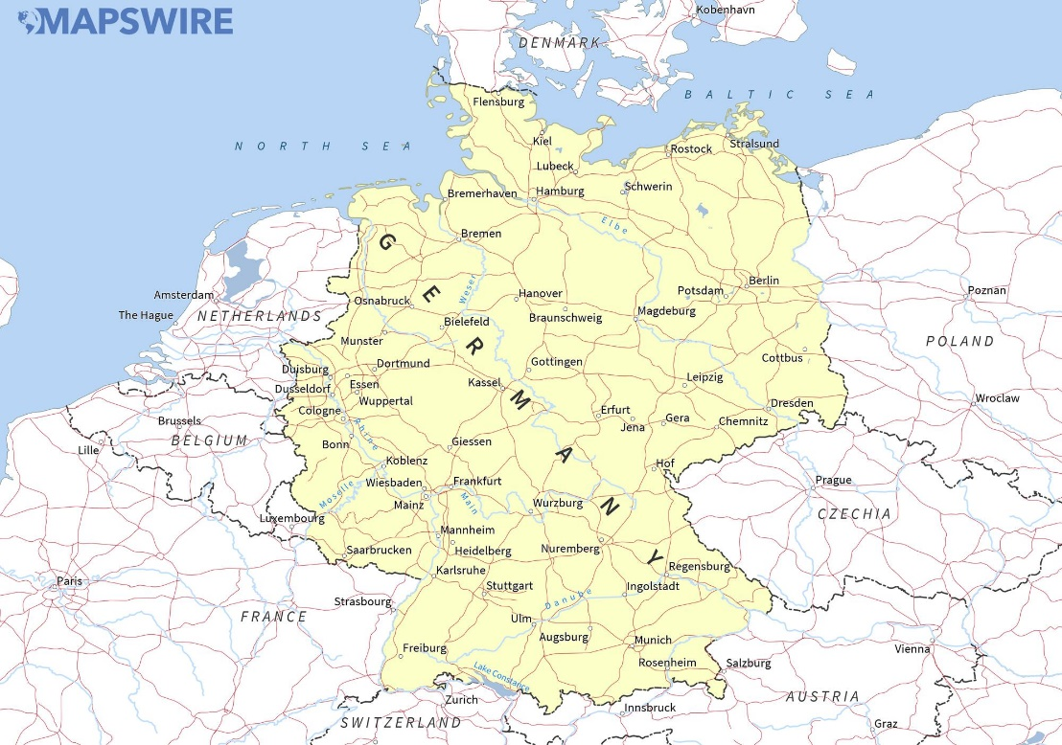
Germany
Western Europe
The name for Germany in the German language is Deutschland.
The population of Germany was around 82 million in 2010.
The capital of Germany is Berlin, it is also the largest city.
Other major cities include Munich, Hamburg, Cologne, Stuttgart and Frankfurt.
Germany is a member of the European Union.
Germany has had an unsettled history, including the Nazi regime and tension between East and West Germany (which were reunified in 1990).
Countries that border Germany include Belgium, the Netherlands, Denmark, Austria, the Czech Republic, France, Luxembourg, Poland and Switzerland.
Germany has the largest economy in Europe.
Large German companies include BMW, Adidas, SAP, Mercedes-Benz, Nivea, Audi, Bayer, Volkswagen and Siemens.

Slide 5
